Slide 1
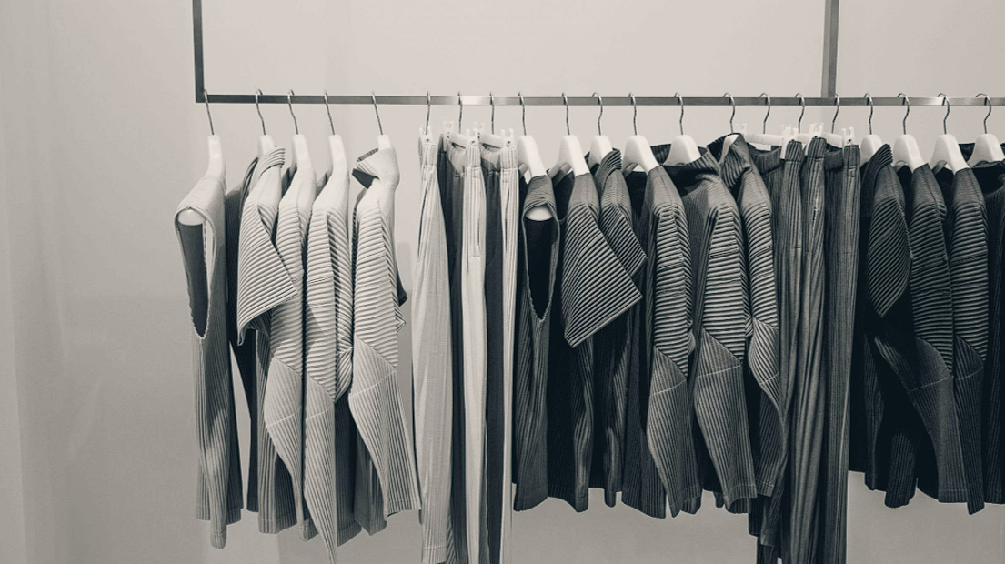

FEBELLA DESIGN
Where Creativity Meets Functionality

Slide 2

Who we are…
Founded in 2024, Febella Design is your trusted partner in creating innovative and sustainable design solutions for a modern world.
Our solid relationships with manufacturers and quality suppliers ensures that we maintain high production standards due to our team of on-site inspection agents.
Our highly competitive product prices and professional service fees position us to operate on shorter lead-times, low margins and ﬂexible moqs.
Febella Design has a strong ability to work with any of the worlds fashion companies. Since our founding in 2013, and our industry experience of 25 years, we are able to create a strong experience based decision on our synergies with clients and are able to deliver a quality that sets us apart from our competitors.

Slide 3





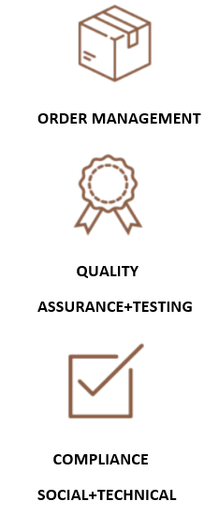

What we do…

Slide 4
From Ideas to Reality…
We’ve got you covered
Development
Manufacturing
Shipping
1.
2.
3.
4.
5.
6.
Consultation
Order placement
QA & QC

Slide 5








Product Groups
Textiles
Footwear
Footwear
Apparel
Home
Textiles
Furniture
Appliances
Accessories
Decor

Slide 6
Why Partner with Us?
One-Stop Shop
Sustainability & Responsibility
Services in every stage of the production process
Key product areas: textiles, footwear, home goods. Experienced in handling multi-channel business requirements
Respect for the environment at all levels of the business
Robust quality management and
compliance framework
International Reach
Digital Solutions
Over 100 audited factories in all major sourcing markets
Can handle large and small MOQs
Virtual product platform; trader documentation service; vendor payment services; iSmart, tSmart, cSmart
Efficient, cost-effective and less waste
6

Slide 7












Supply Chain Sustainability.
Delivering lasting benefits to business and the environment.
EcoVero™ Viscose,
Global Recycle Standard (GRS)
Lenzing
GOTS
BCI
Sustainable Materials
Detox and OI: Chemical Management Assessment
Eco- Responsible Production
Example tools:
Chemical
Management
Sustainable Packaging
For samples
For shipments
Higg FEM
amfori BEPI
7

Slide 8
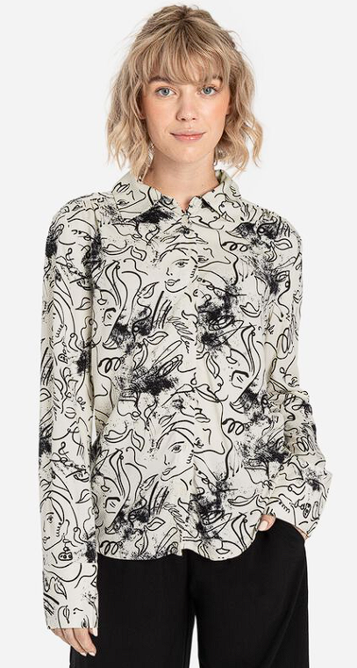
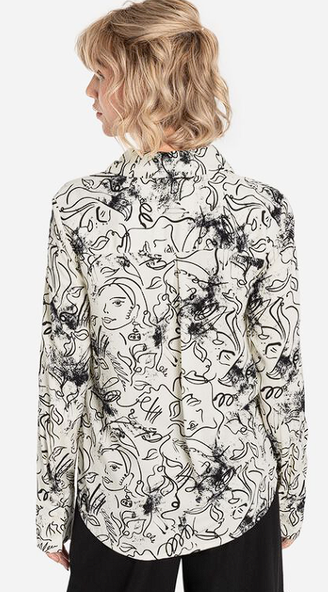
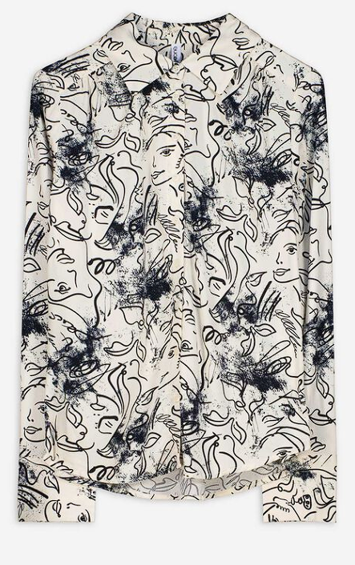

Real to Life Simulation

Slide 9
Management.
RICHA SAWHNEY
MANAGING DIRECTOR
Richa has 30+ years experience in managing buying operations of leading international Mail-Order and Retail companies.
She was part of The Otto Group management responsible for operations in India.
She has in-depth experience with the Indian subcontinent markets with thorough knowledge of sourcing and vendor management.

Slide 10
We’re here……
Contact us..
Febella Design
richa@febelladesign.com
info@febelladesign.com

